Slide 1

HallyuGo:
A Guide Map to Discover and Visit K-Contents and K-Culture Hotspots
Team 4.75 김지수 이유진 정대교 Jose Antunes

Slide 2
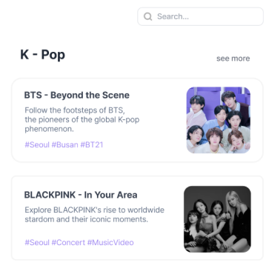
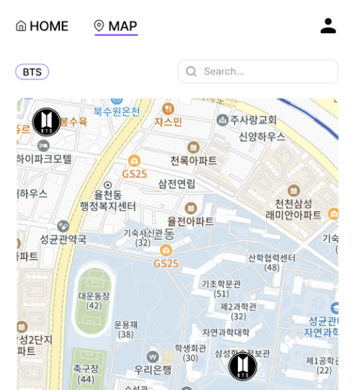
Recap: Topic
Guide map to search and visit Hallyu hotspots
In Korean, “성지순례"

Slide 3
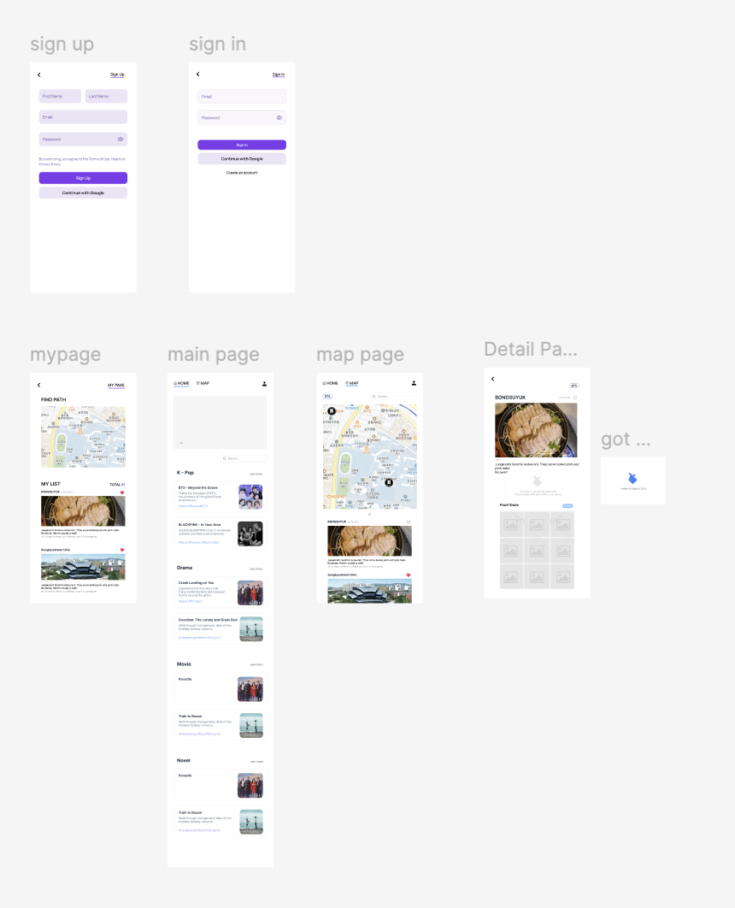
Progress: This week
Wireframe from Figma by Yoojin
Notes:
What have done by whom this week?

Slide 4

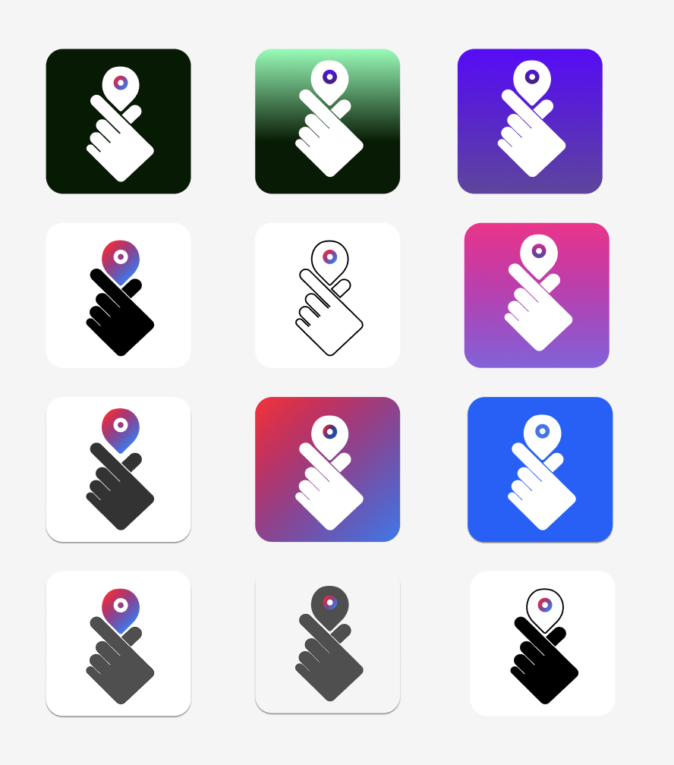
Progress: This week
Logo design
K-Heart
Map Icon
Red - Blue

Slide 5
Technical Background: Frontend
What is a PWA?
Progressive Web App
Combines the best of the web and native apps
Supported by 97% of web browsers
Can be installed by 88% of web users
Used by companies like Starbucks and Twitter

Slide 6
Technical Background: Frontend
Why PWA?
No need for installation through the App Store
Supports cross-platform functionality
Acts like a native application
Can access native app features like:
Camera, push notifications, GPS
Pre-caching for improved performance
Low learning curve
SEO-friendly!
Can be used offline

Slide 7
Technical Background: Frontend
Why Zustand and Yarn?
Zustand:
Small bundle size
Minimizes unnecessary component re-renders
No need for a provider
Yarn:
Faster and more lightweight compared to NPM

Slide 8
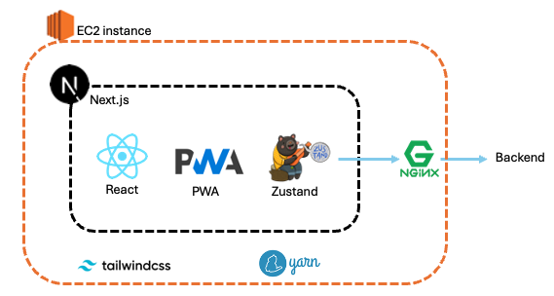
Preparation & Setup: Frontend
Overall Design

Slide 9
Preparation & Setup: Frontend
Setup (Next.js & PWA)
Web App manifest File
Service worker
Icon image
Lint (ESLint)

Slide 10
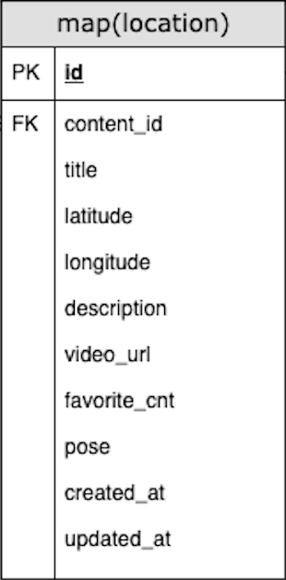
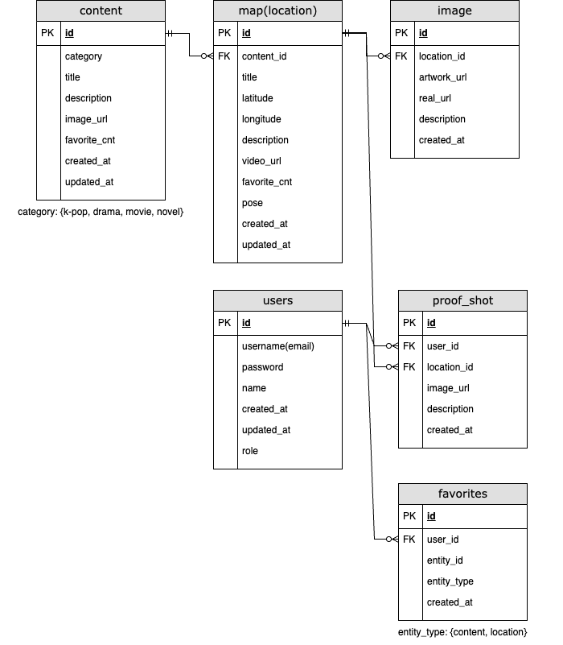
Progress: This week
DB(Version 1) by Daegyo
Location
Geographic coordinates
Description
Video link ex) YouTube
Recommended pose

Slide 11
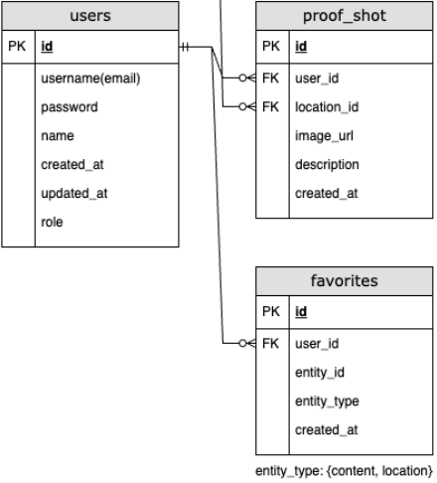
Progress: This week
DB(Version 1) by Daegyo
Users
Proof shot
Favorites

Slide 12
Technical Background: Backend
AWS RDS and S3
RDS: Managed relational database service
Deployment using AWS
Database performance, scalability, security, and high availability
S3: Scalable object storage service
Large amount of image files(still image, real image, proof shot etc.)
Efficient image management

Slide 13
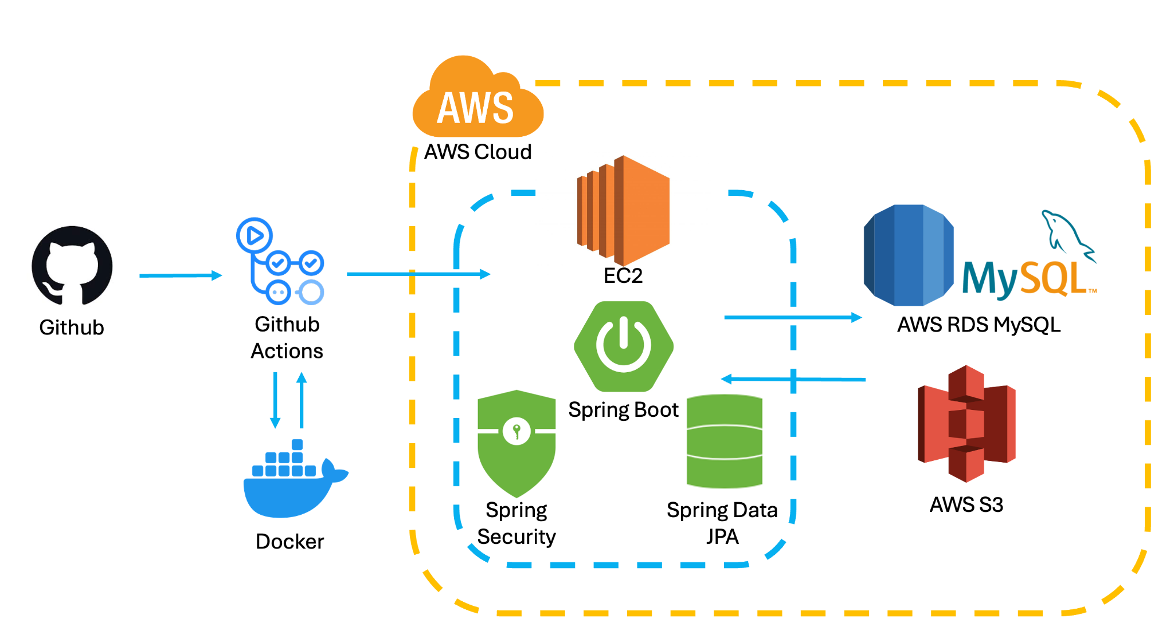
Preparation & Setup: Backend
Overall Design

Slide 14
Preparation & Setup: Backend
Setup (Spring Boot)
Setting FlywayDB
Basic Setting for MySQL
Merged at main (github)

Slide 15
Dataset Collection
We find the places related Hallyu ourselves on
SNS like Instagram, X, …
Travel platform we researched
Blog
by Jisu, Jose

Slide 16
Progress: Next week
Jisu | Start API design, Dataset Collection
Yoojin | Complete overall ui design, Implement basic layout
Daegyo | Complete DB design, Start API design
Jose | Dataset Collection, Write use case scenarios
Notes:
What will do by whom next week?
Domain address
Front-Back API
Dataset collection
Use Case Scenarios

Slide 17
Thank you for listening

